Slide 1
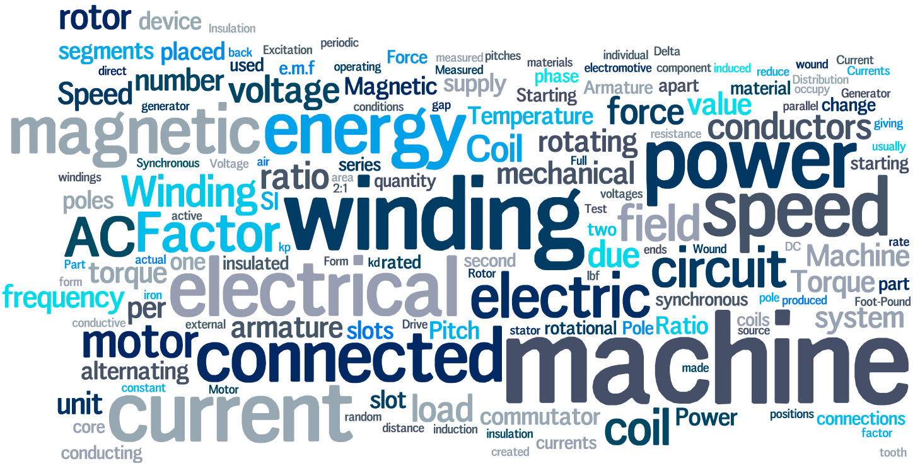
Electrical Engineering
.
…
Christopher Bauman – www.chrisbauman.com.au

Slide 3
https://youtu.be/yAz9Ungv2Xc safety video
https://youtu.be/1UuLvTJp-I0

